Slide 1
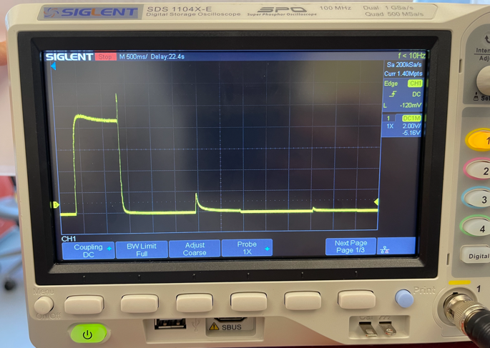
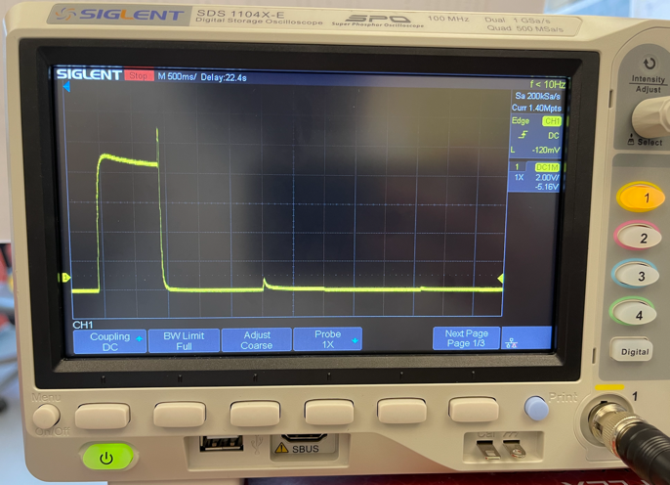
Recorded 6.26.2024
Notes:
Left image = vacuum OFF, right image = vacuum ON
HARP-based, ran with Bonsai.
Pinene 100% bottle and blank bottle used. PIN -> Blank -> Blank.
PID setting
Offset: 48
Gain: 1x
Pump: High
Flow rate: 75ml / bottle
Time variables (ms)
switchTime1 = 35 (supposed to be 30; added 5ms due to Bonsai’s timing delay problem)
switchTime2 = 0
vacuumDelay = 25 (supposed to be 20; added 5ms due to Bonsai’s timing delay problem)
portValveCycleTime = 110
vacuumDuration = 10

Slide 2
